Slide 1




LDPTrace: Locally Differentially Private Trajectory Synthesis
Yuntao Du^{1,2}, Yujia Hu¹, Zhikun Zhang³, Ziquan Fang¹, Lu Chen¹, Baihua Zheng⁴, Yunjun Gao¹
¹College of Computer Science, Zhejiang University, China
²Department of Computer Science, Purdue University, USA
³Department of Computer Science, Stanford University, USA
⁴School of Computing and Information Systems, Singapore Management University, Singapore
Notes:
Hi everyone, My name is Yuntao Du. It is an honor to share our work “LDPTrace: Locally Differentially Private Trajectory Synthesis”
This is a jointed work with different researchers from Zhejiang, Purdue, Stanford, and Singapore management university.

Slide 2
Outline
Motivation
Preliminaries
Related Work
Methods
Experimental Evaluation
Conclusions
Notes:
First I will introduce the motivation of this work, then provide some basic knowledge and related work, next I will present our method and show experimental results. Finally I will conclude our contributions.

Slide 3
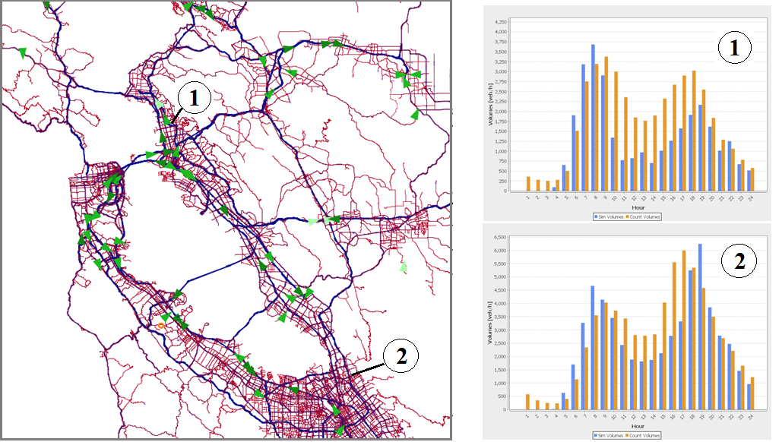
Motivations
Trajectory data publication
Urban mobility modeling at scale
Smart traffic design is critical, congestion is getting worse
Epidemiology monitoring
Important to analysis and forecast the disease spread
Location-based services and so on…
Notes:
Trajectory data has the potential to greatly benefit a wide-range of real-world applications, such as monitoring and improving traffic condition, tracking the spread of the disease through people’s movement patterns and providing personalized location-based services.
Recent years we have seen many trajectory dataset has been released for research purpose, such as Geolife, T-drive, and porto datasets. However, since most trajectory data is consist of human movement, which is very sensitive and has been shown that they are also easy to attack.
3

Slide 4
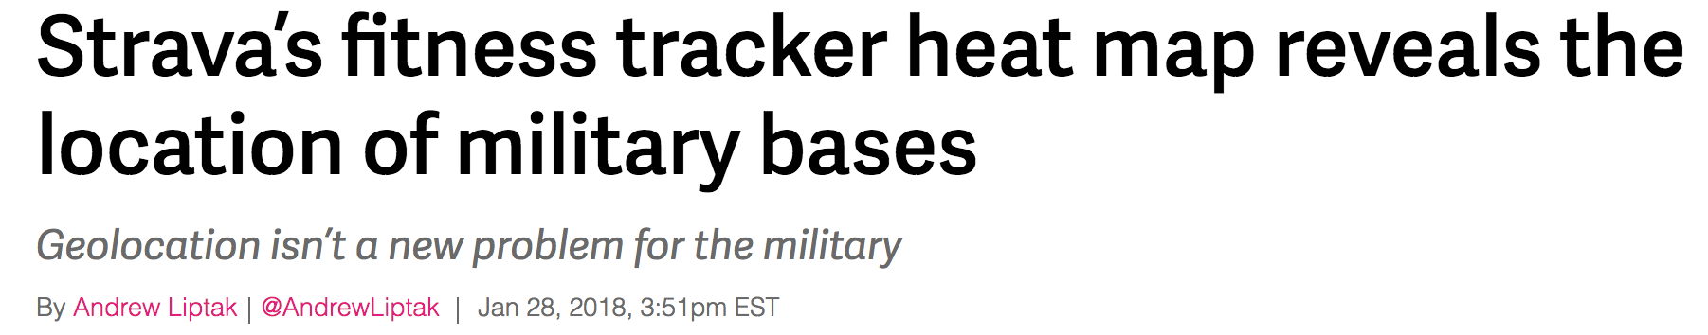
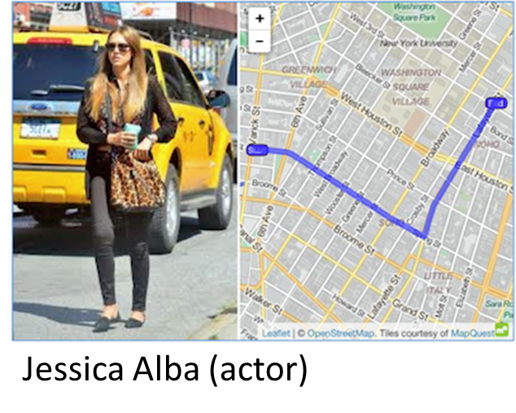
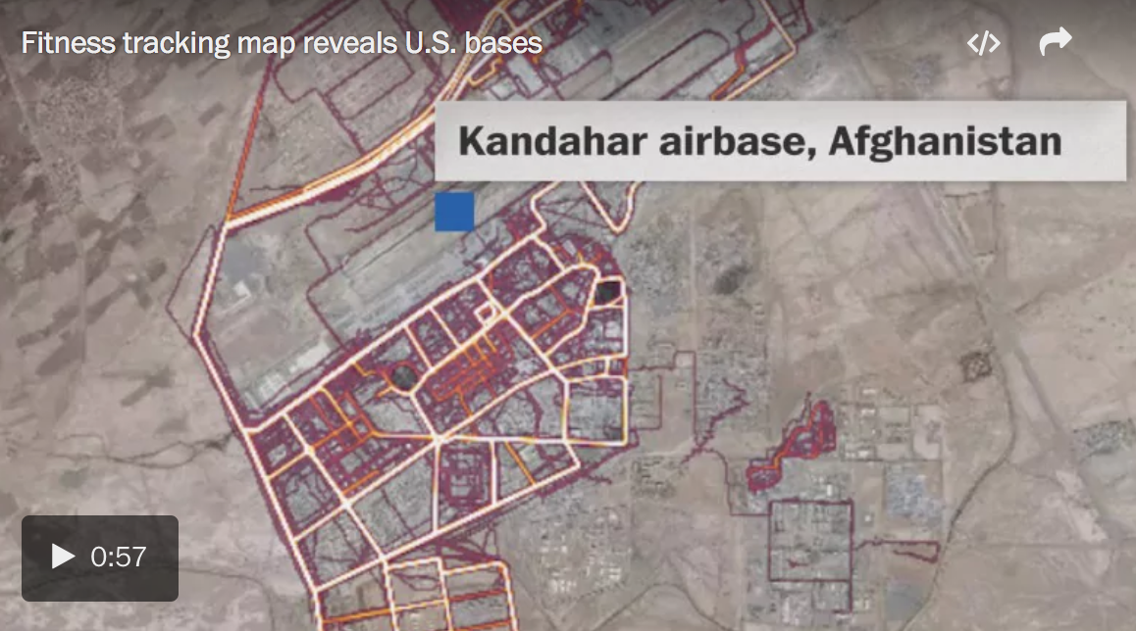
Motivations
Data Release Horror Stories
We need to solve this data release problem ...
Notes:
And recent years we have seen many horror news from data release.
For example, attackers could use GPS data to track someone’s house, working place, or even secret military bases.
And even with some privacy-preserving techniques like anonymization, these personal information can easily be revealed, which is a serious problem for anyone who want to release datasets to public.
So it is very important to solve the data publication problem without sacrificing user’ privacy.
4

Slide 5
Outline
Motivation
Preliminaries
Related Work
Methods
Experimental Evaluation
Conclusions
Notes:
Next, I introduce some basic background knowledge

Slide 6
Preliminaries
Centralized Differential Privacy (CDP)
Core idea: Any output should be about as likely regardless of whether or not I am in the dataset.
Trustworthy
Randomization
Algorithm
Statistical results satisfy:
Aggregator
Notes:
Differential privacy has become the golden standard for protecting sensitive data while ensuring individual privacy, which has been adapted by many governments and companies.
The general idea of DP is to guarantee that a single sample has limited impact on the output of an algorithm. Formally, given two neighboring datasets differing on one sample, after perturbing with some random noise, their probability of outputting the same value is bounded by a value epsilon.
点击
In centralized differential privacy, it assumes that there is a trusted data aggregator who has all the original data, so people need to report all their raw data to data curator, and rely on the aggregator to protect their privacy while performing downstream tasks.
6

Slide 7
Preliminaries
Local Differential Privacy (LDP)
In the local setting of DP, the aggregator is untrusted.
Randomization
Algorithm
Untrustworthy
Randomization
Algorithm
Aggregator
Randomization
Algorithm
Randomization
Algorithm
LDP is good, but hard to achieve because of the strict privacy protection.
Notes:
However, for many situation, the data aggregator also cannot be trusted. So recent years, local differential privacy has been studied.
点击
Local differential privacy assumes the aggregator is also untrusted, which is a very strict privacy algorithm since that no one except the data creator has the access to the raw data.
Specifically, each user locally perturb their private data using a randomization algorithm. After receiving the perturbed data, the aggregator will conduct some aggregation to extract useful information.
点击
So LDP is good, but hard to achieve a good balance between privacy and data utility.
7

Slide 8
Outline
Motivation
Preliminaries
Related Work
Methods
Experimental Evaluation
Conclusions
Notes:
Next, I will introduce some existing works on trajectory publication.

Slide 9
Related Work
CDP-based trajectory publication
Point perturbation methods: add noise to each locations [CCS 13, KDD 14, CIKM 13, ICDE 17, etc.]
Generative methods: generate synthetic trajectories that resembles real traces [KDD 12, VLDB 15, S&P 16, CCS 18, ICDE 21, etc.]
LDP-based trajectory publication
Point perturbation method with external knowledge: NGRAM [VLDB 21]
Poor global utility
Auxiliary knowledge dependence
Computational overhead
Vulnerable to attacks
Problems:
Notes:
Trajectory publication under centralized differential privacy has been extensively studied for recent years. General speaking, there are two kinds of methods to public privacy-preserving trajectory data.
The first one is perturbing-based methods, which means that we add noises to each locations and use these perturbed points to construct new trajectories or answer spatial-based queries.
The second one is generative-based methods, which collects important features and add noise to them, and uses these perturbed features to generate synthetic trajectoroes.
点击
There are also some attempt to publish trajectory under local differential privacy. However, in local settings, since we can only access user local trajectory, it is much harder to preserve data utility. The only work that can meet the strict privacy requirement of LDP, is to use external knowledge to directly perturbs individual trajectory with exponential mechanism in the form of overlapped n-grams in the user side, and then form an optimization problem to reconstruct perturbed trajectories.
点击
However, we argue that this approach suffers from from poor utility, additional knowledge dependence, high computational overhead, as well as very vulnerable to various spatial attacks.
9

Slide 10
Outline
Motivation
Related Work
Preliminaries
Methods
Experimental Evaluation
Conclusions
Notes:
In the following, we present our proposed methods.

Slide 11
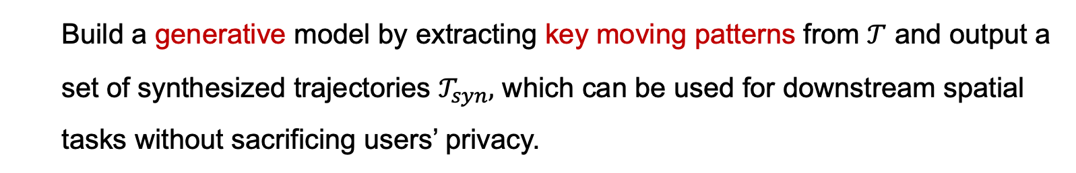
Problem Statement
Build a generative model by extracting key moving patterns from $𝒯$ and output a set of synthesized trajectories $𝒯_{syn},$ which can be used for downstream spatial tasks without sacrificing users’ privacy.
Key Patterns
LDP Protocol
Key Patterns
Original trajectories
Synthetic trajectories
Privacy perserving
High utility
Practicability and efficiency
Attack resilience
Desired properties:
Notes:
So first, the task of this work is to build a generative model by extracting key moving patterns from individual orignal trajectory, and use local differential privacy to perturb and report these features, then the data center collect those perturbed features and generate synthetic trajectories for downstream tasks.
点击
We thinks the output synthesized trajectories datasets should satisfy four properties:
First, the whole synthesis process should strict grantee local differential privacy to preserve users’ privacy,
Second, the syntheses trajectories should resemble true trajectories from different global as well as individual utility aspects,
Third, considering the wide usage of trajectory data, our solution is preferred to be as simple as possible so that it can be easily deployed to any local devices without heavy computation, so the privacy and utility do not come at the cost of user experience.
Last, it would be better that the synthesis data can against common location-based attacks.
11

Slide 12
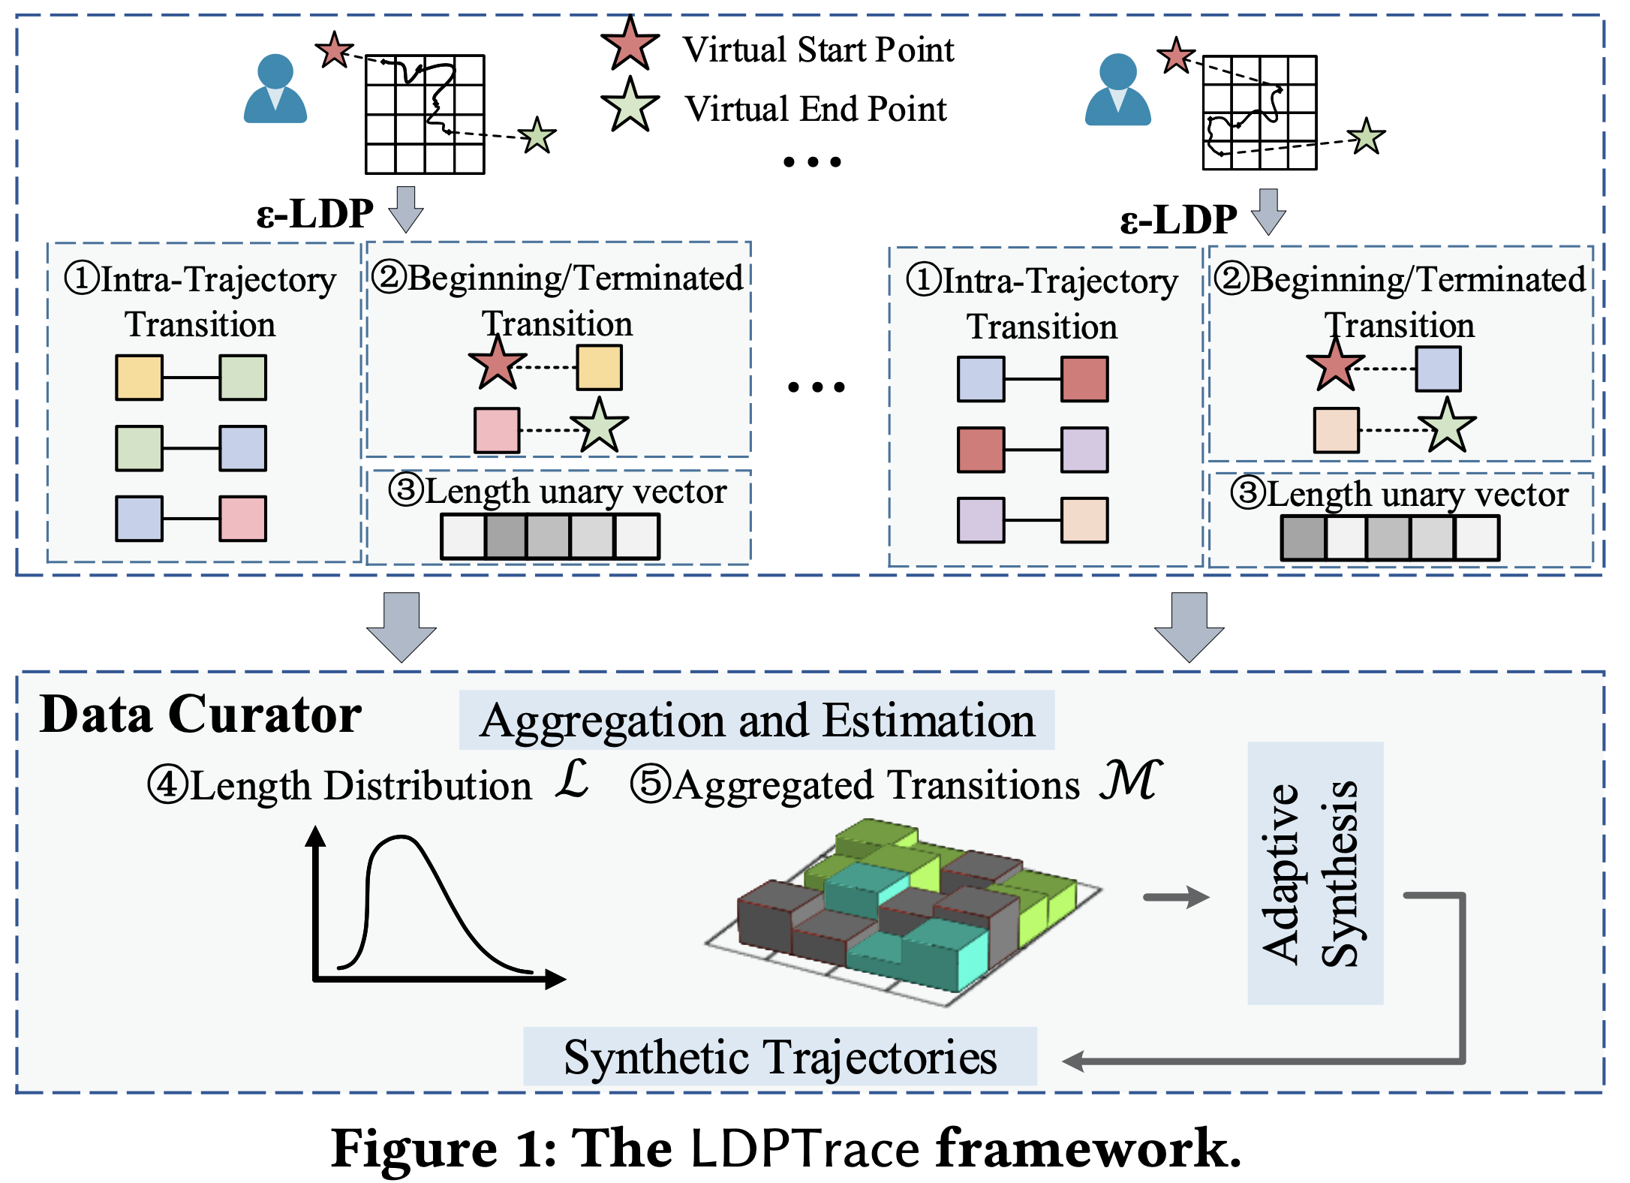
Overview
Notes:
So let take a look of the framework of our method, LDPTrace. I use two users as an example to demonstrate the process.
First, we discrete the geo space into grid, and also discrete the trajectories into grid sequence and add the virtual start and virtual end point to each trajectory.
12

Slide 13
Overview
Notes:
Instead of directly perturbing each location point, we aim to extract the key movement patterns of each user and use them to synthesize realistic trajectories. There are three main components of LDPTrace.
13

Slide 14
Overview
Intra-Trajectory Mobility Model
Intra-Trajectory Mobility Model
Notes:
The first is intra-trajectory mobility model, which estimates the transition of trajectory and capture the movement patterns of users, which is essential for our synthesis process.
14

Slide 15
Overview
Beginning/Terminated Transitions
Beginning/Terminated Transitions
Notes:
The second is the beginning and terminated transitions, which could indicate the start/end points of trajectories, used for determining the start/ending state for generation.
15

Slide 16
Overview
Length Distribution
Estimation
Length Distribution
Estimation
Notes:
The last is the length distribution, which can indicate the travel distance of users’ motions, and serves as the deterministic constraint to terminate the synthesis.
16

Slide 17
Overview
Notes:
And the data curator collects all the features from each user, and aggregates them to estimate the length distribution as well as the transition distribution, and use them to generate synthetic trajectories.
点击
So the core of LDPTrace is to effectively collect the key features of trajectories, next I will show you how to estimate these features under local differential privacy.
17

Slide 18
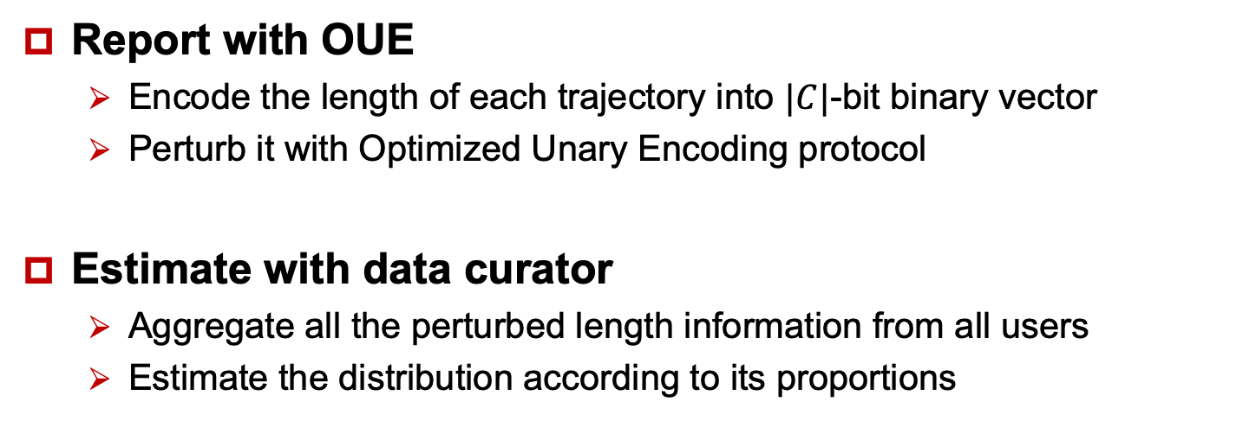
Component 1: Trajectory Length Distribution
Report with OUE
Encode the length of each trajectory into $|C|$-bit binary vector
Perturb it with Optimized Unary Encoding protocol
Estimate with data curator
Aggregate all the perturbed length information from all users
Estimate the distribution according to its proportions
OUE
Aggregate
OUE
Estimated length distribution
Notes:
点击
First, for trajectory length estimation, we perturb the trajectory length locally and report them with optimized unary encoding, which is a popular LDP protocol for frequency estimation.
点击
After all the perturbed length has been collected by data curator, we aggregate them to estimate the distribution according to its proportions.
18

Slide 19
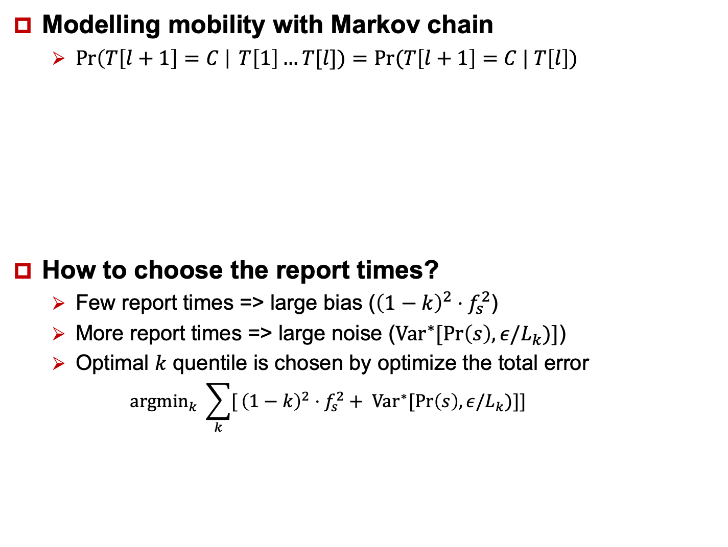
Component 2: Intra-Trajectory Mobility Model
Modelling mobility with Markov chain
$\operatorname{Pr}\left(T\left[l+1\right]=C \right| T\left[1\right]…T[l])=Pr⁡(T\left[l+1\right]=C | T\left[l\right])$
How to choose the report times?
Few report times => large bias (${\left(1−k\right)}^{2}⋅f_{s}^{2}$)
More report times => large noise (${Var}^{∗}[Pr\left(s\right), ε/L_{k})]$)
Optimal $k$ quentile is chosen by optimize the total error
$${{argmin}_{k} \sum_{k}{[}{\left(1−k\right)}^{2}⋅f_{s}^{2}+ Var}^{∗}[Pr\left(s\right), ε/L_{k})]]$$
Trade-off!
Notes:
For mobility estimation, we model the transitions of each trajectory with one-order Markov chain and report them to data curator with optimized unary encoding. 点击
点击
The question is that how to select proper report times. If each trajectory report transition information too many times, the privacy budge for each transition would be small, which would lead to large noise（点击）. On the other hand, if the report times are too few, the estimation bias would be dominated （点击）. So there is a trade-off between small estimation bias and small perturb noise.
点击
We tackle this problem by using the k-th quantile of estimated length distribution, the optimal k should balance the noise error as well as the estimation errors. (power-law distribution)
)
19

Slide 20
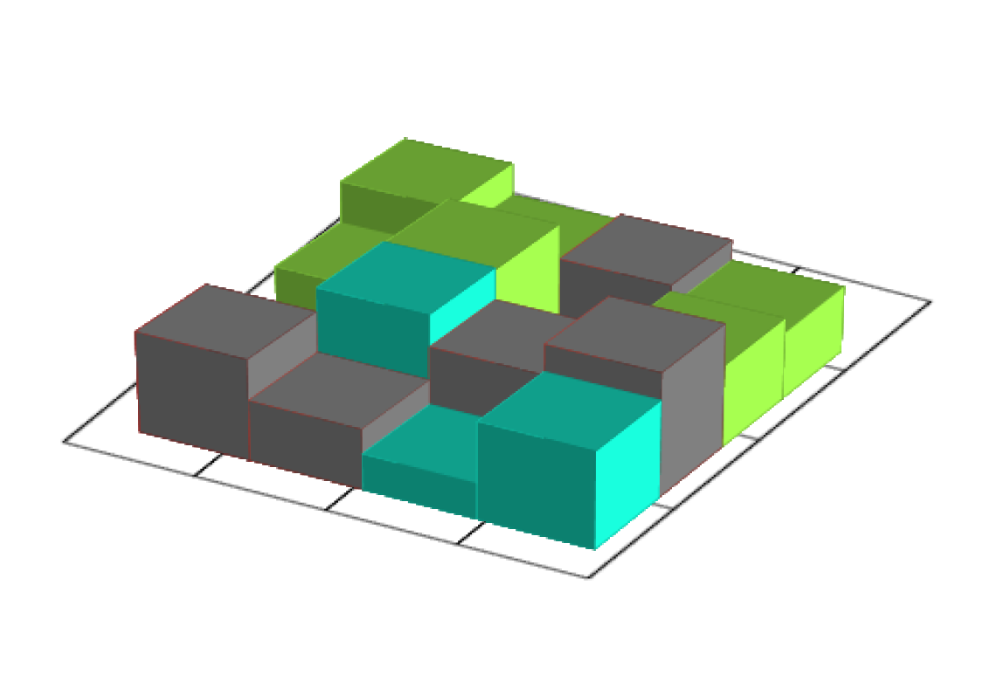
Component 3: Beginning/Terminated Transitions
Start/end points
Reveal the important spatial semantic: pickups, home/work places, destinations
Add special virtual start/end points for each trajectory, and using the same mobility model to perturb/aggregate
Aggregate with intra-trajectory transitions to form the aggregated mobility model
OUE Protocol
Virtual
Start points
Virtual
end points
Estimation
OUE Protocol
Trajectory Mobility
Notes:
The final component that we would like to model is the beginning and terminated transitions.
We separate this from other intra-transitions because them only occur once for each trajectory, and on many situations, they can play an important role to identify users’ information like pickup locations, home/work places, etc.
点击
What we do is adding special virtual start/end points for each trajectory, and use them to report the beginning and terminated transitions to form the final trajectory mobility.
20

Slide 21

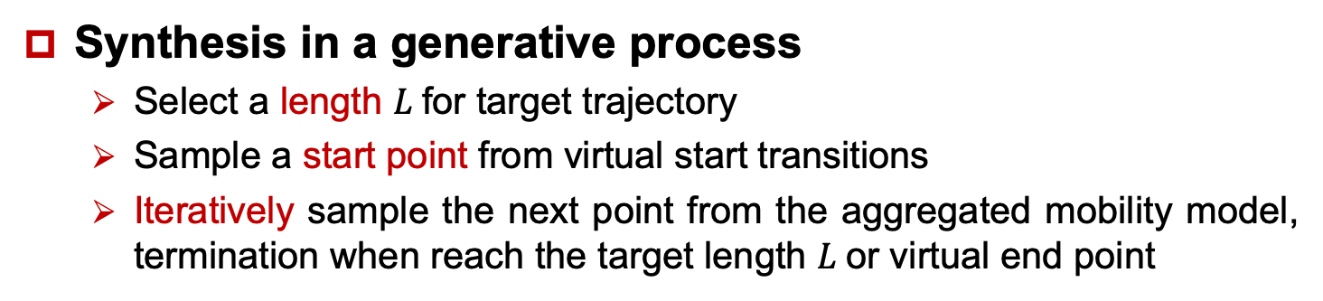
Trajectory Synthesis
Synthesis in a generative process
Select a length $L$for target trajectory
Sample a start point from virtual start transitions
Iteratively sample the next point from the aggregated mobility model, termination when reach the target length $L$or virtual end point
Sample a length $L$
Estimated length distribution
Synthetic trajectory
Sample a beginning transition
Trajectory Mobility
Notes:
And this is the overall synthesis algorithm for LDPTrace.
As it shows, during synthesis, we first randomly select a target length from length distribution, and sample a start point for virtual start transitions, then iteratively sample the next point according to the learned transition distribution until it reach the target length or virtual end point.
21

Slide 22
Outline
Motivation
Related Work
Preliminaries
Methods
Experimental Evaluation
Conclusions
Notes:
Here, we analyze the experimental results.

Slide 23
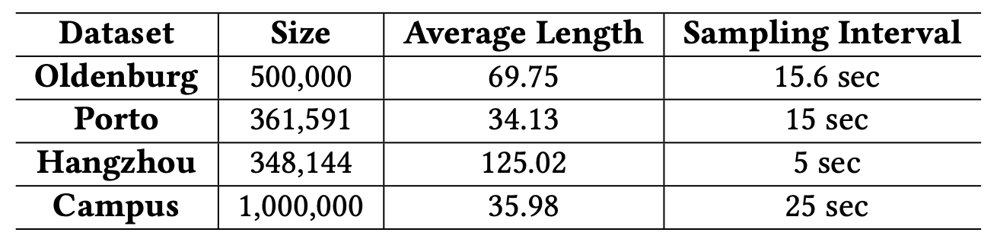
Experimental Evaluation
Datasets
Evulation metrics
Global level: Density error, Query error, Hotspot Query error, Kendall-tau
Trajectory level:, trip error, length error, diameter error
Semantic level: pattern F1, pattern error
Notes:
We use two synthesized datasets and two real-world datasets to evaluate performance.
First, we evaluate utility in three aspects: global level, trajectory level and semantic level. Each level has serval spatial metrics that can comprehensively evaluate the performance of synthetic trajectories.
23

Slide 24
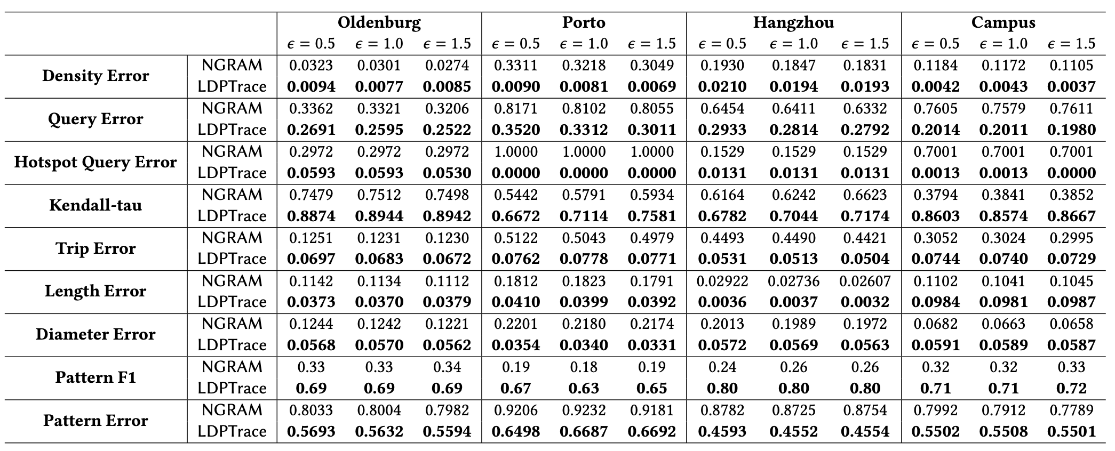
Experimental Evaluation
Utility performance
Global level
Trajectory level
Semantic level
Our method outperform baselines on every level of trajectory utilities.
Notes:
As shown in this table, 点击 under any metrics and privacy budget, our method greatly outperforms the baseline in all metrics across all datasets.
This is especially true for global level and semantic level, since our method is able to capture the global spatial information while the baseline is perturbed locally and cannot model the global distribution.
不需要了
but, many spatial tasks are based on global spatial utilities, such as range query, hotspot detection and pattern discovery. So it is very important to preserve these features in synthstic trajectories.
24

Slide 25
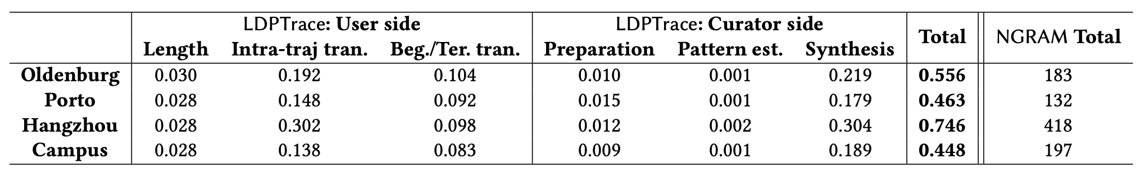
Experimental Evaluation
Efficiency
Evaluate the average process time per 1,000 trajectories
Our method has two orders of magnitude improvement compared to the baseline method. The process time of a single trajectory is at the level of submillisecond.
Notes:
Then we evaluate the efficiency of LDPTrace.
We split the computation on user side and data curator side. Since our method only need to perturb to key features instead of every locations, it is much more efficient than previous method. In fact, LDPTrace has two orders of magnitude efficiency improvement compared to the baseline method.
25

Slide 26
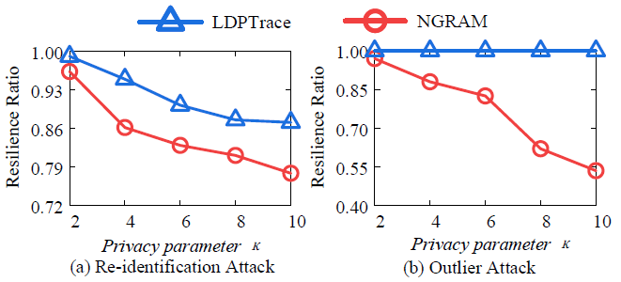
Experimental Evaluation
Attack resilience
Re-identification attack: use adversary knowledge (e.g. subtrajectories) to identify the individual user in the published dataset and acquire information about attacked user’s whole trajectory
Outlier attack: trajectories with irregular attributes in the published dataset will be easier to be distinguished from other normal trajectories, which may cause privacy leakage.
Notes:
And we also find that our synthesized trajectories are robust to various attacks. We test it with two pupular location-based attacks.
The first is re-identification attack. The attackers use adversary knowledge (e.g. subtrajectories) to identify the individua trajectories in the published dataset
And the other is outlier attack, which aims to detect abnormal trajectories according to lengths and traveling distance.
点击
And we find more than 88% trajectories can be successfully protected in re-identification attack, and almost all trajectories can be hidden from outliers. Which is much better than previous method.
26

Slide 27
Outline
Motivation
Related Work
Preliminaries
Algorithms
Experimental Evaluation
Conclusions
Notes:
At last, I conclude our work.

Slide 28
Conclusions
The first LDP trajectory synthesis. We present the first trajectory synthesis solution with local differential privacy guarantee without any external knowledge.
A neat and effective framework. LDPTrace collects key moving patterns from each user, and devise an adaptive synthesis algorithm to generate authentic traces with nearly no computational overhead.
Theoretical guarantee. Comprehensive analysis on the errors and complexity of LDPTrace, and present a guideline for selecting the grid granularity.
Extensive experiments. Considerable experimental results demonstrate the superiority of LDPTrace.
Notes:
We propose the first LDP trajectory synthesis algorithm which can strict satisfy local differential privacy without relying on any external knowledge.
And we propose a neat and effective framework to extract key patterns for generation with very small computational overhead.
We also provide the theoretical guarantee to the algorithm complexity, and extensive experiments show that LDPTrace outperforms previous methods by a large margin.
28

Slide 29
Thank you !
Questions?
ytdu@zju.edu.cn
LDPTrace: Locally Differentially Private Trajectory Synthesis
https://github.com/zealscott/LDPTrace
VLDB 2023
Poster Session: 5:00PM – 7:00PM (#117)
Notes:
Thank you for your listening. Our codes and datasets are all available on Github.
If you have any question about our work, feel free to contact me.
And also welcome you guys to talk to me at the poster session.
29

Slide 30
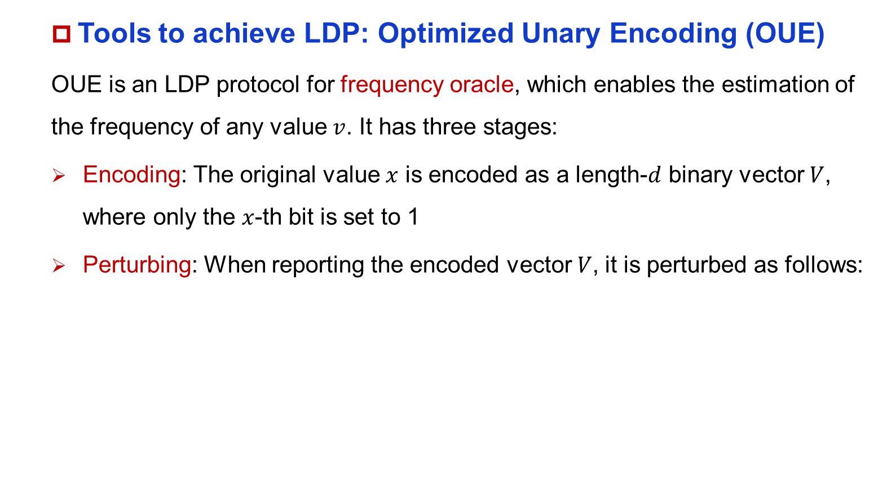
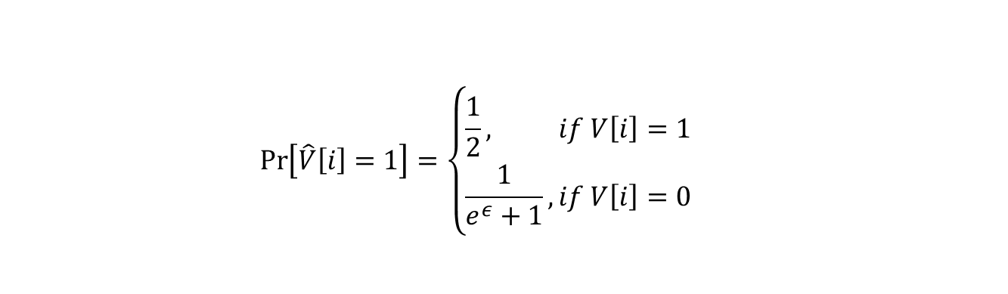
Preliminaries
Tools to achieve LDP: Optimized Unary Encoding (OUE)
OUE is an LDP protocol for frequency oracle, which enables the estimation of the frequency of any value $v$. It has three stages:
Encoding: The original value $x$ is encoded as a length-$d$ binary vector $V$, where only the $x$-th bit is set to 1
Perturbing: When reporting the encoded vector $V$, it is perturbed as follows:
$$\operatorname{Pr}\left[\hat{V}\left[i\right]=1\right]=\left\{\begin{aligned}&\frac{1}{2}, &if V\left[i\right]=1 \\ &\frac{1}{e^{ε}+1},&if V\left[i\right]=0\end{aligned}\right.$$
Notes:
There are many techniques to achieve local differential privacy, we use the most popular one, called optimized unary encoding, which is a frequency oracle enables the estimation of the frequency of any value.
First is encoding, which encode original value
目前实现LDP的技术有很多，我们介绍一种最常用的做法，也是我们在论文里面所用到的技术，叫做Optimized Unary Encoding (OUE)。
OUE可用于对任何frequency的变量进行隐私保护和统计，他主要由三个部分组成：
Encoding。原始的数据值x被encode到一个d维的binary向量，只有第x个bit为1，其余都为0。
Perturb。当用户上传数据x的时候，我们对这个binary向量根据下面的公式进行随机扰动，这个公式可以保证其满足LDP的数学定义。
30

Slide 31
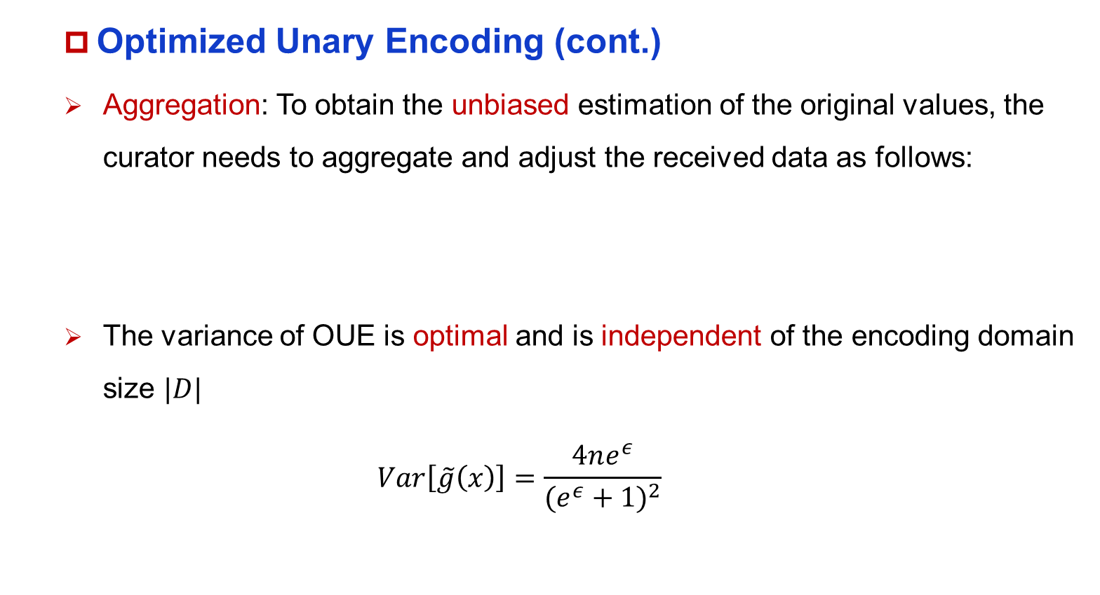

Preliminaries
Optimized Unary Encoding (cont.)
Aggregation: To obtain the unbiased estimation of the original values, the curator needs to aggregate and adjust the received data as follows:
The variance of OUE is optimal and is independent of the encoding domain size $|D|$
$$Var\left[\tilde{g}\left(x\right)\right]=\frac{4ne^{ε}}{(e^{ε}+1)^{2}}$$
$$\tilde{g}\left(x\right)=\frac{\hat{g}\left(x\right)−nq}{\frac{1}{2}−q}, q=\frac{1}{e^{ε}+1}$$
Notes:
3. 将扰动后的数据上传到不可信的数据中心进行聚合，同时数据中心对得到的数据进行修正，可以保证最后得到的g(x)是x的无偏估计，同时其variance满足下面的式子。
31

Slide 32
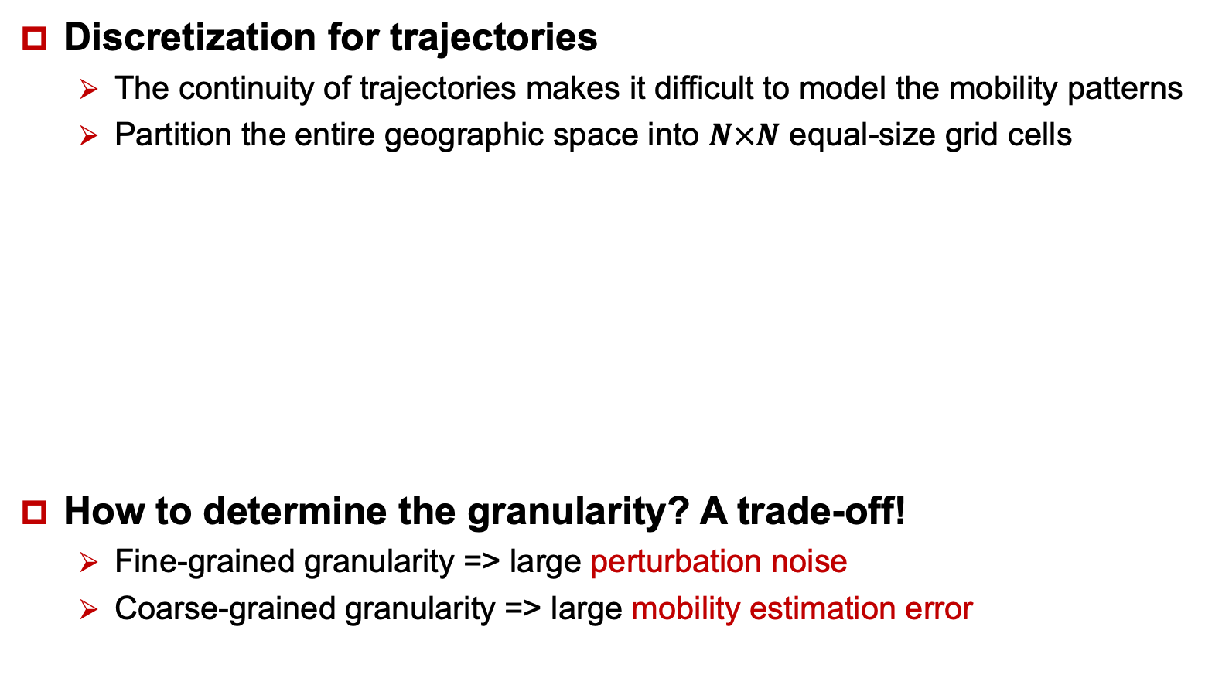
Geospatial Discretization
Discretization for trajectories
The continuity of trajectories makes it difficult to model the mobility patterns
Partition the entire geographic space into $N×N$ equal-size grid cells
How to determine the granularity? A trade-off!
Fine-grained granularity => large perturbation noise
Coarse-grained granularity => large mobility estimation error
Discretization
Original Trajectory
Sequence data with cells
Notes:
Specifically, we first need to
32

Slide 33
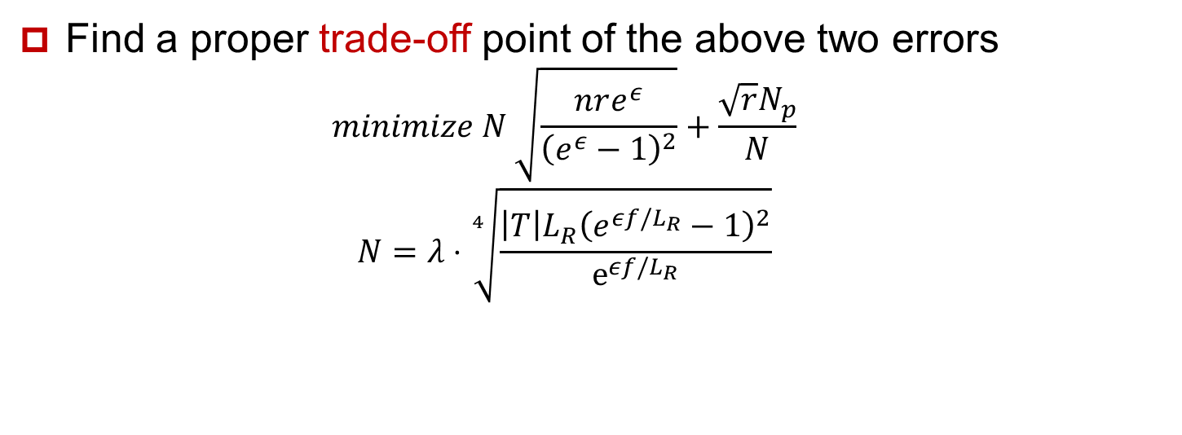
Selecting the Grid Granularity
The granularity of grid has influence on two kinds of errors:
Perturbation noise: risk of having empty cells, which leads to high noise as well as inefficiency.
Finer granularity => larger perturbation noise
Mobility estimation error: causes captured mobility patterns will be too general and uninformative.
Coarser granularity => larger estimation error
Find a proper trade-off point of the above two errors
$$minimize N \sqrt{\frac{nre^{ε}}{{\left(e^{ε}−1\right)}^{2}}}+\frac{\sqrt{r}N_{p}}{N}$$
$$N=λ⋅\sqrt[4]{\frac{\left|T\right|L_{R}{\left(e^{εf/L_{R}}−1\right)}^{2}}{ⅇ^{εf/L_{R}}}}$$
Notes:
Perturbation noise: when reporting the transition distribution, noise is added locally, smaller grid will incur the risk of having many empty cells, which leads to high noise as well as inefficiency.
Mobility estimation error: larger grid will make too many points in the original trajectory be represented by on single cell. Thus, the captured mobility patterns will be too general and uninformative.
33

